Slide 1
Introduction to Julia: Why are we doing this to you? (Spring 2020)
Steven G. Johnson, MIT Applied Math
MIT classes 18.06, 18.S191, 18.S096,
18.303, 18.330, 18.08[56],
18.335, 18.337, …
these slides, cheatsheets, links:
https://github.com/mitmath/julia-mit

Slide 2
What language for teaching scientific computing?
For the most part, these are not hard-core programming courses,
and we only need little “throw-away” scripts and toy numerical experiments.
Almost any high-level, interactive (dynamic) language with easy facilities for linear algebra (Ax=b, Ax=λx), plotting, mathematical functions, and working with large arrays of data would be fine.
And there are lots of choices…

Slide 3
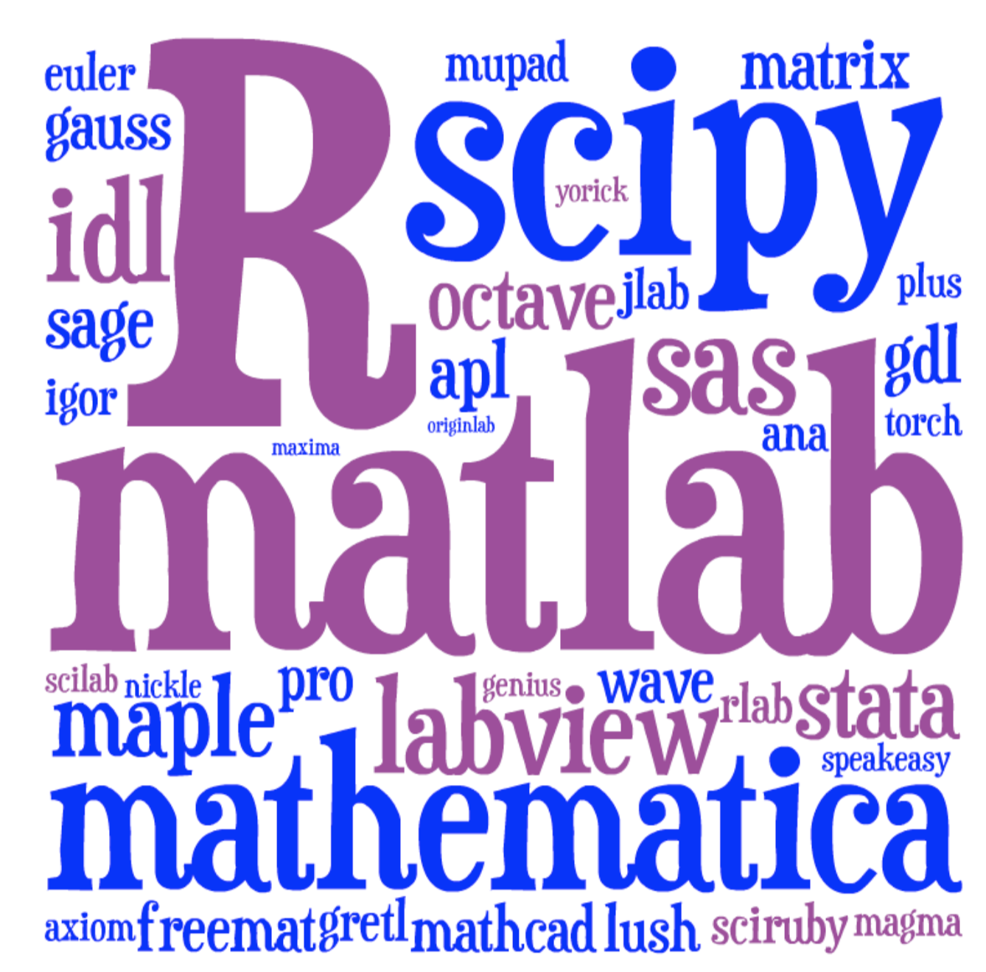
Lots of choices for interactive math…
[ image: Viral Shah ]

Slide 4
Just pick the most popular? Matlab or Python or R?
We must often use another a language for our “real work”.
Traditional HL computing languages
hit a performance wall in “real” work
… eventually force you to C, Cython, Fortran, Numba…

Slide 5





A new programming language?
Viral Shah
Jeff Bezanson
Alan Edelman
[ MIT ]
julialang.org
Stefan Karpinski
[begun 2009, “0.1” in 2013, ~50k commits,
1.0 release in 2018, 1.5 in Aug. 2020 ]
[ 40+ developers with 100+ commits,
4000+ external packages, 7th JuliaCon in 2020 ]
As high-level and interactive as Matlab or Python+IPython,
as general-purpose as Python,
as productive for technical work as Matlab or Python+SciPy,
but as fast as C.

Slide 6
Lots of performance discussions, benchmarks, tutorials online… Let’s just look at one simple example.

Slide 7
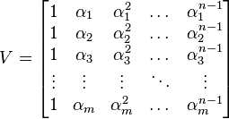
Generating Vandermonde matrices
given x = [α₁, α₂, …], generate:
NumPy (numpy.vander): [follow links]
Python code …wraps C code
… wraps generated C code
type-generic at high-level, but
low level limited to small set of types.
Writing fast code “in” Python or Matlab = mining the standard library
for pre-written functions (implemented in C or Fortran).
If the problem doesn’t “vectorize” into built-in functions,
if you have to write your own inner loops … sucks for you.

Slide 8
Vandermonde matrices: Julia vs NumPy
function vander(x, n=length(x))
m = length(x)
V = Array{eltype(x)}(undef, m, n)
for j = 1:m
V[j,1] = one(x[j])
end
for i = 2:n
for j = 1:m
V[j,i] = x[j] * V[j,i-1]
end
end
return V
end
note: works for any container
of any type with “*” operation
… performance ≠ inflexibility
NumPy-1.18 time / Julia-1.5 time

Slide 9
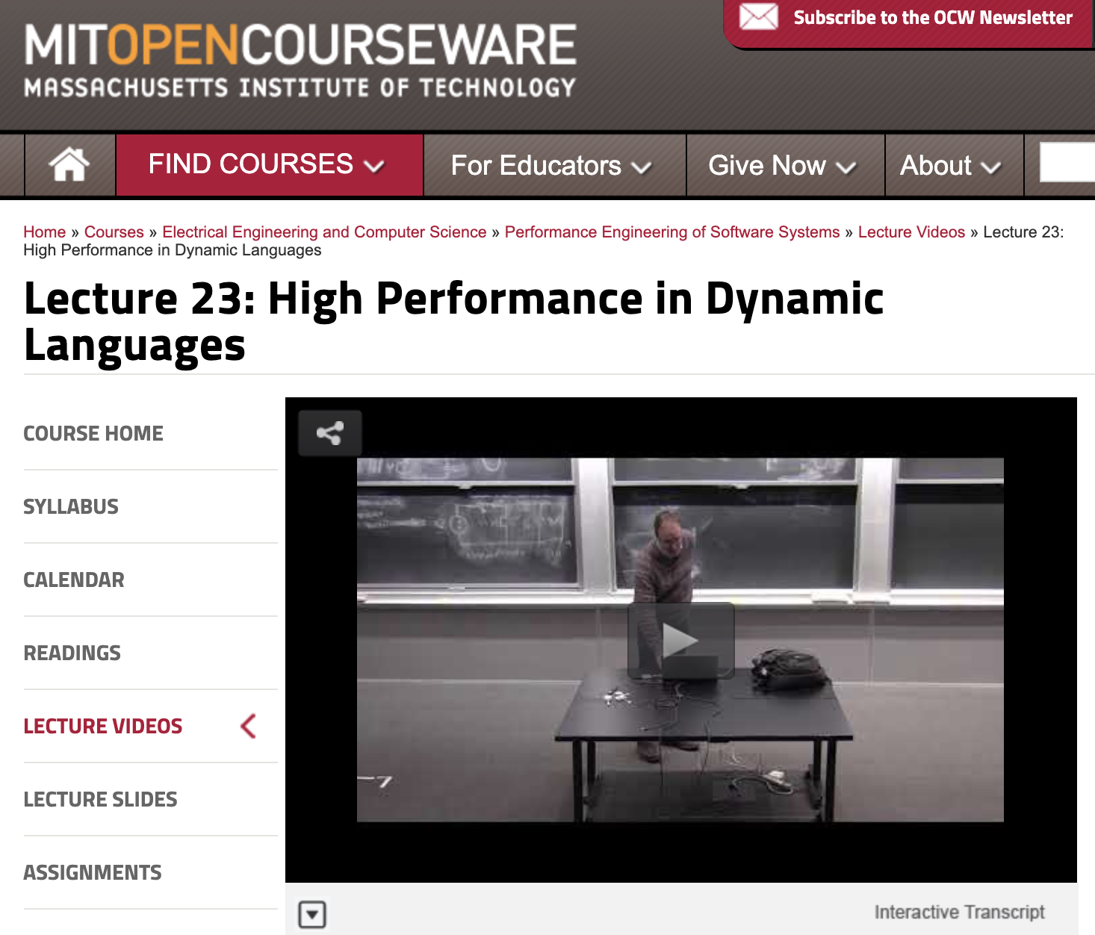
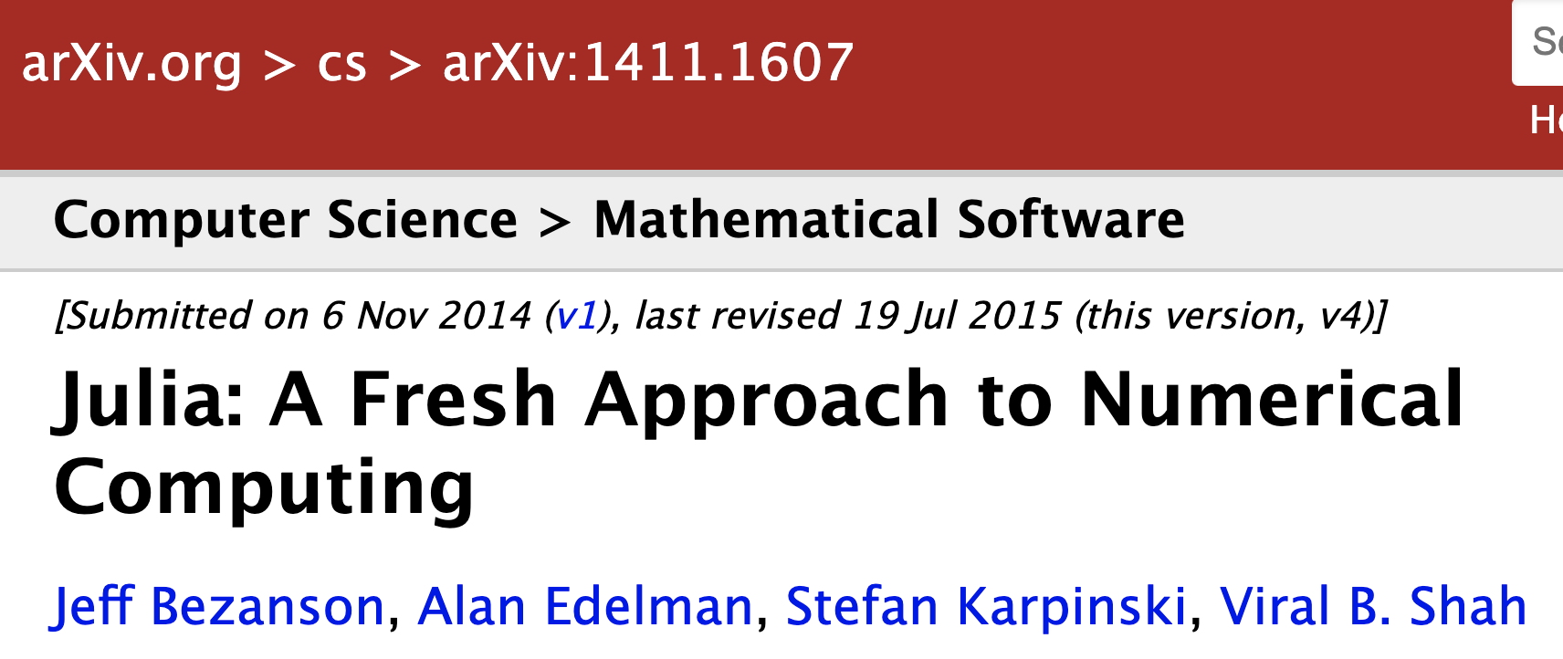
Why is Julia fast? A topic for another day.
See my 6.172 “guest lecture”
from 2018:
https://bit.ly/2QUrgB4
The original paper:

Slide 10
But I don’t “need” performance!
For lots of problems, especially “toy” problems in courses, Matlab/Python performance is good enough.
But if use those languages for all of your “easy” problems, then you won’t be prepared to switch when you hit a hard problem. When you need performance, it is too late.
You don’t want to learn a new language at the same time that you are solving your first truly difficult computational problem.

Slide 11
Just vectorize your code? = rely on mature external libraries, operating on large blocks of data, for performance-critical code
Good advice! But…
• Someone has to write those libraries.
• Eventually that person will be you.
— some problems are impossible or
just very awkward to vectorize.

Slide 12
But everyone else is using Matlab/Python/R/…
Julia is still a young, niche language. That imposes real costs — lack of familiarity, rough edges, continual language changes. These are real obstacles.
But it also gives you advantages that Matlab/Python users don’t have.

Slide 13
But I lose access to all the libraries available for other languages?
Very easy to call C/Fortran libraries from Julia, and also to call Python…

Slide 14
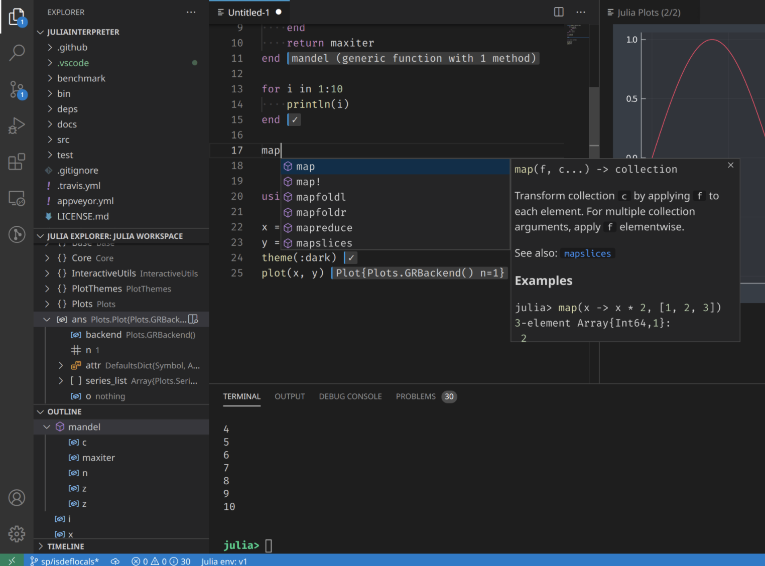
Julia Coding Environments
Of course, full-featured “IDE” coding environments are available with VSCode, Atom, not to mention Emacs, Vim, …
and Julia has the usual features for organizing large programs into files, data structures, modules…
+ integrated hypertext documentation support…
+ built-in github-integrated package manager for distributing & installing packages and dependencies…
Julia + VSCode
… but today we’re only looking at interactive snippets of code:
Julia as a “glorified calculator.”

Slide 15
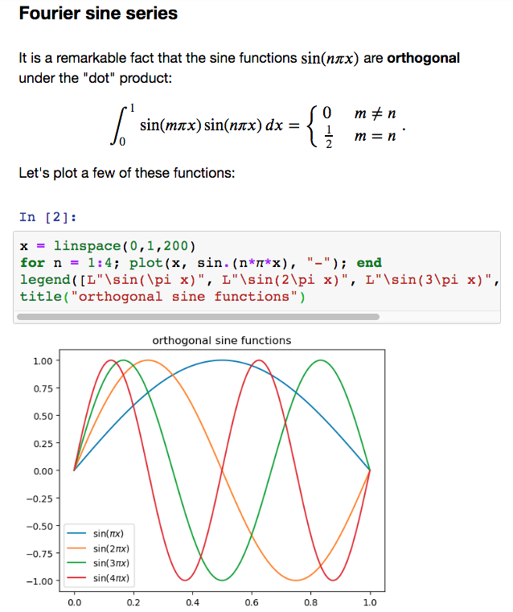
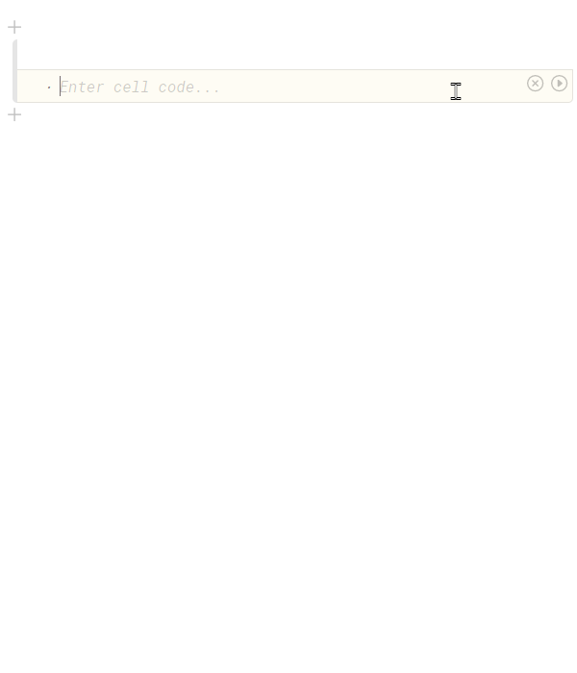
Julia Interactive-Computing Environments
Jupyter notebooks:
code+text+
equations+images+…
+ Julia backend
= IJulia

